Slide 1
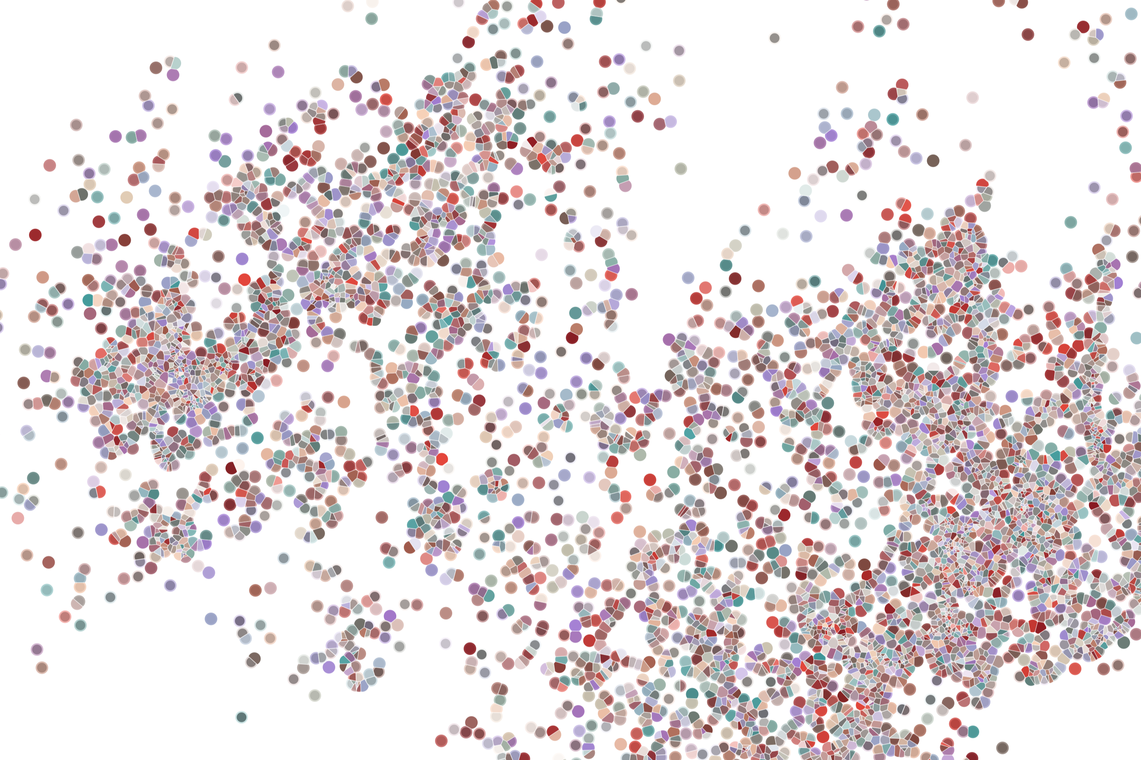
R/Bioconductor 201
Physalia course 2022
Instructor: Jacques Serizay
Notes:
Hello everybody and thank you for attending my presentation. I am going to talk about the project I recently started working on in the Spassky and Koszul labs, both located in Paris. This project focuses on the unusual cooption of the mitotic machinery to drive, not cell division but cell differentiation.

Slide 2
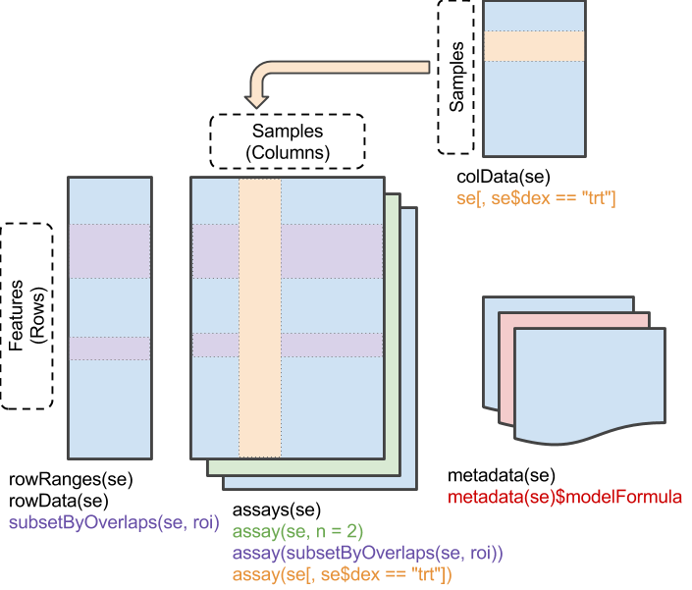
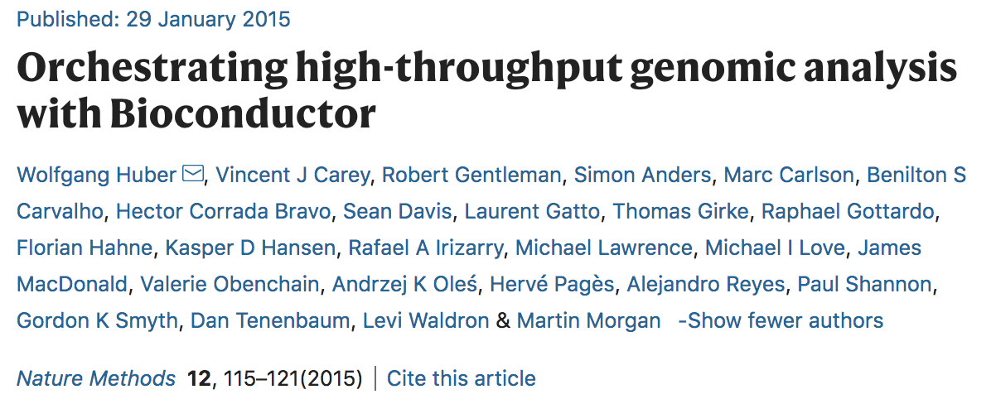
SummarizedExperiment

Slide 3
SummarizedExperiment
colData(): Annotations on each column, as a DataFrame.
E.g., description of each sample

Slide 4
SummarizedExperiment
rowData/rowRanges(): Annotations on each row.
E.g., coordinates of gene / exons /peaks in transcripts / etc.

Slide 5
SummarizedExperiment
assay(), assays(): A matrix-like or list of matrix-like objects of identical dimension
rows: refer to rowRanges: genes, genomic coordinates, etc.
columns: refer to colData: samples, cells, etc.
Implements dim(), dimnames() and 2-dimensional [ , ]
Can be several assays!!!

Slide 6
SummarizedExperiment
metadata(): List of unstructured metadata describing the overall content of the object.

Slide 7
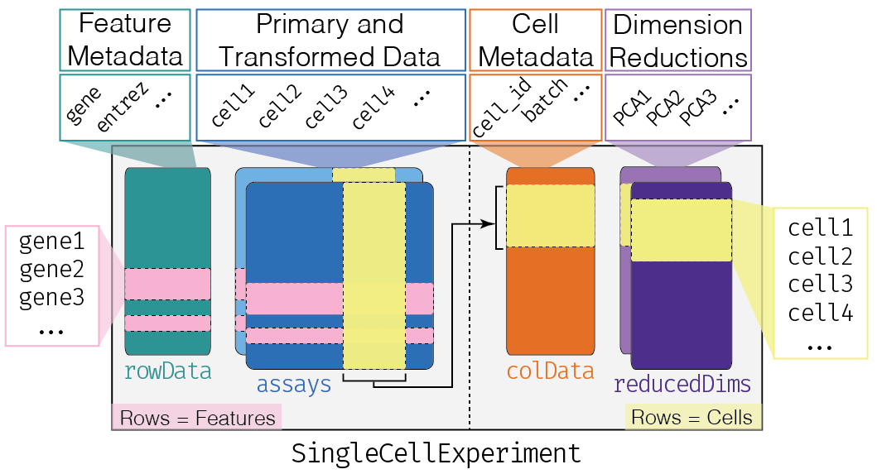
Classes derived from SummarizedExperiment
SingleCellExperiment

Slide 8
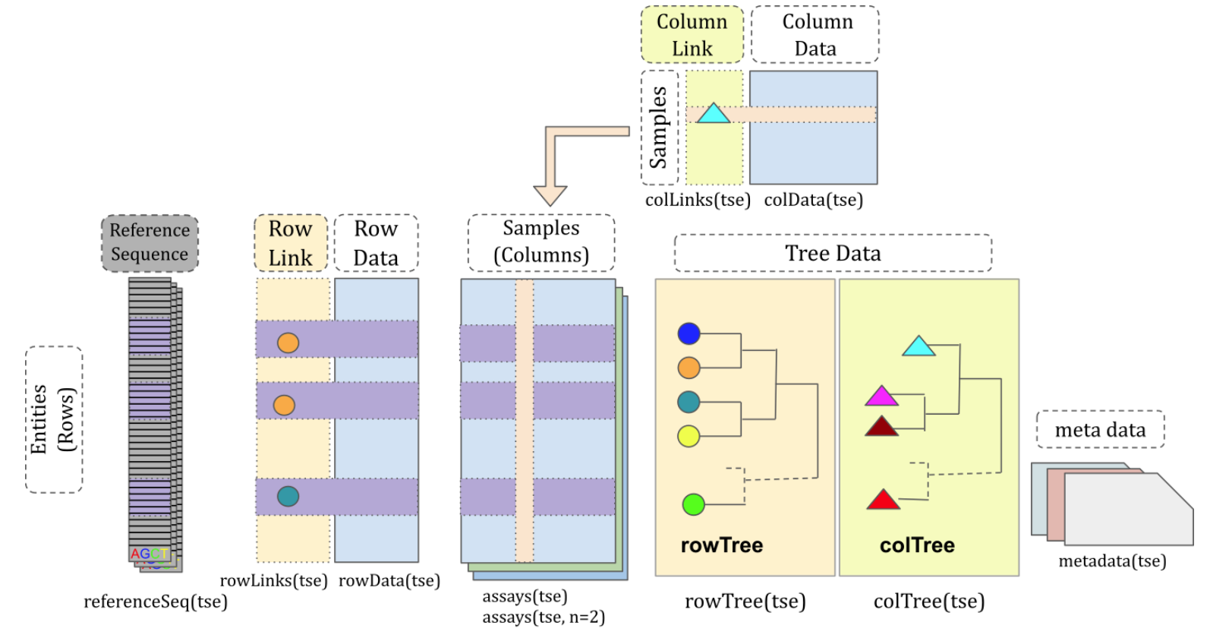
Classes derived from SummarizedExperiment
TreeSummarizedExperiment

Slide 9
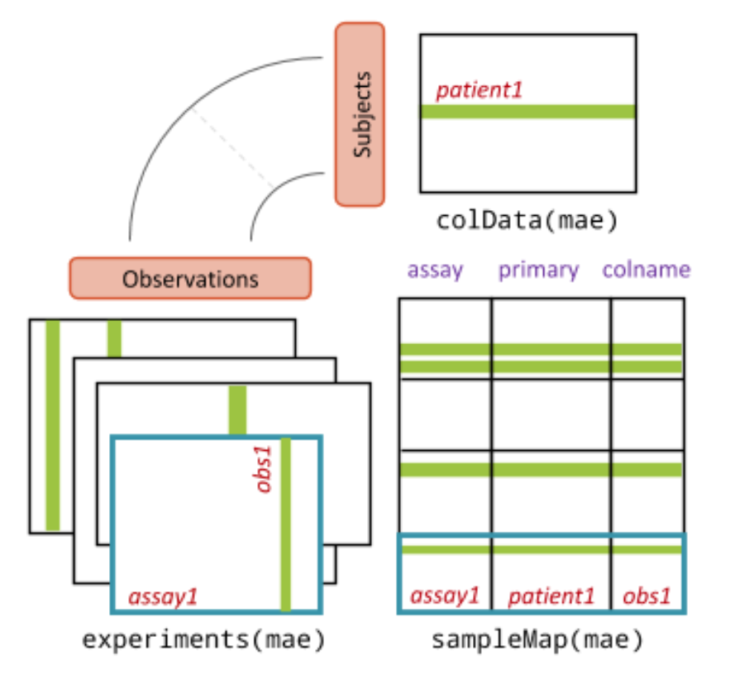
Classes derived from SummarizedExperiment
MultiAssayExperiment

Slide 10
BPPARAM
Genomic analyses require heavy resources
Generally, benefits from parallelization

Slide 11
BPPARAM
Genomic analyses require heavy resources
Generally, benefits from parallelization
BiocParallel is a Bioconductor package designed to reduce the complexity faced when developing and using software that performs parallel computations
BiocParallel aims to provide a unified interface to existing parallel infrastructures where code can be easily executed in different environments

Slide 12
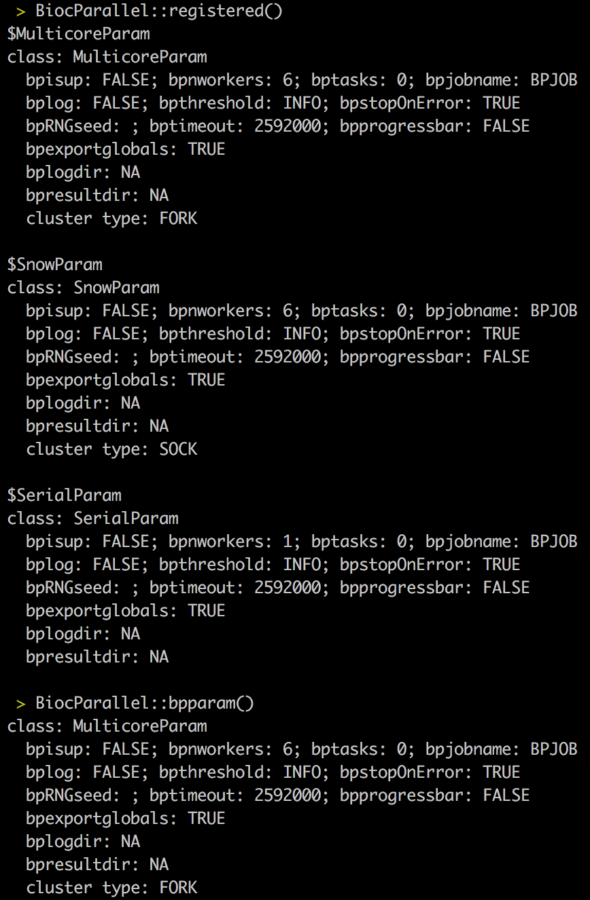
BPPARAM
Declaring configurations:
registered()
bpparam()
register(…, default = TRUE)

Slide 13
BPPARAM
Declaring configurations:
registered()
bpparam()
register(…, default = TRUE)
MulticoreParam()
SerialParam()
SnowParam()

Slide 14
BPPARAM
Execute in parallel:
bplapply()
e.g., bplapply(1:4, FUN)

Slide 15
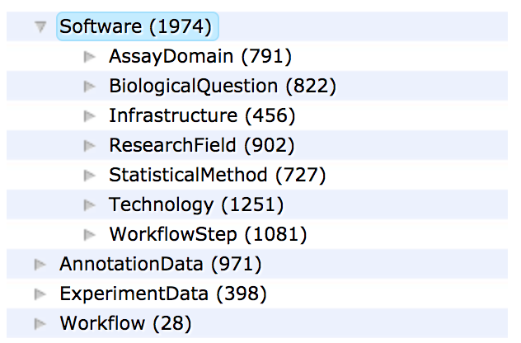
Bioconductor is not only for analysis packages
https://www.bioconductor.org/packages/release/BiocViews.html

Slide 16
Bioconductor is not only for analysis packages
https://www.bioconductor.org/packages/release/BiocViews.html
Software (1974)
AssayDomain (791)
BiologicalQuestion (822)
Infrastructure (456)
ResearchField (902)
StatisticalMethod (727)
Technology (1251)
WorkflowStep (1081)
AnnotationData (971)
ChipManufacturer (388)
ChipName (196)
CustomArray (2)
CustomDBSchema (6)
FunctionalAnnotation (31)
Organism (634)
PackageType (682)
SequenceAnnotation (1)
Workflow (28)
AnnotationWorkflow (3)
BasicWorkflow (5)
EpigeneticsWorkflow (4)
GeneExpressionWorkflow (11)
GenomicVariantsWorkflow (2)
ImmunoOncologyWorkflow (14)
ProteomicsWorkflow (2)
ResourceQueryingWorkflow (2)
SingleCellWorkflow (2)
ExperimentData (398)
AssayDomainData (81)
DiseaseModel (90)
OrganismData (139)
PackageTypeData (41)
RepositoryData (94)
ReproducibleResearch (22)
SpecimenSource (103)
TechnologyData (266)

Slide 17
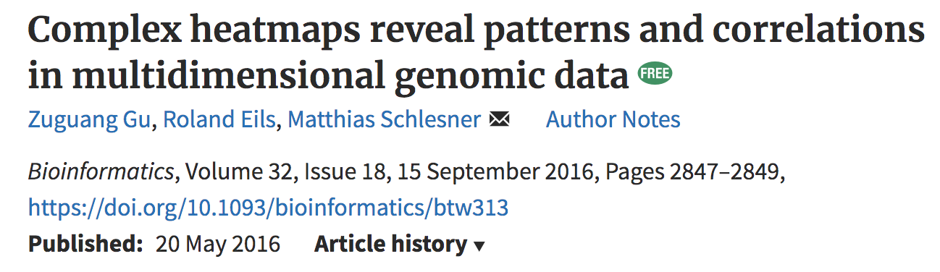
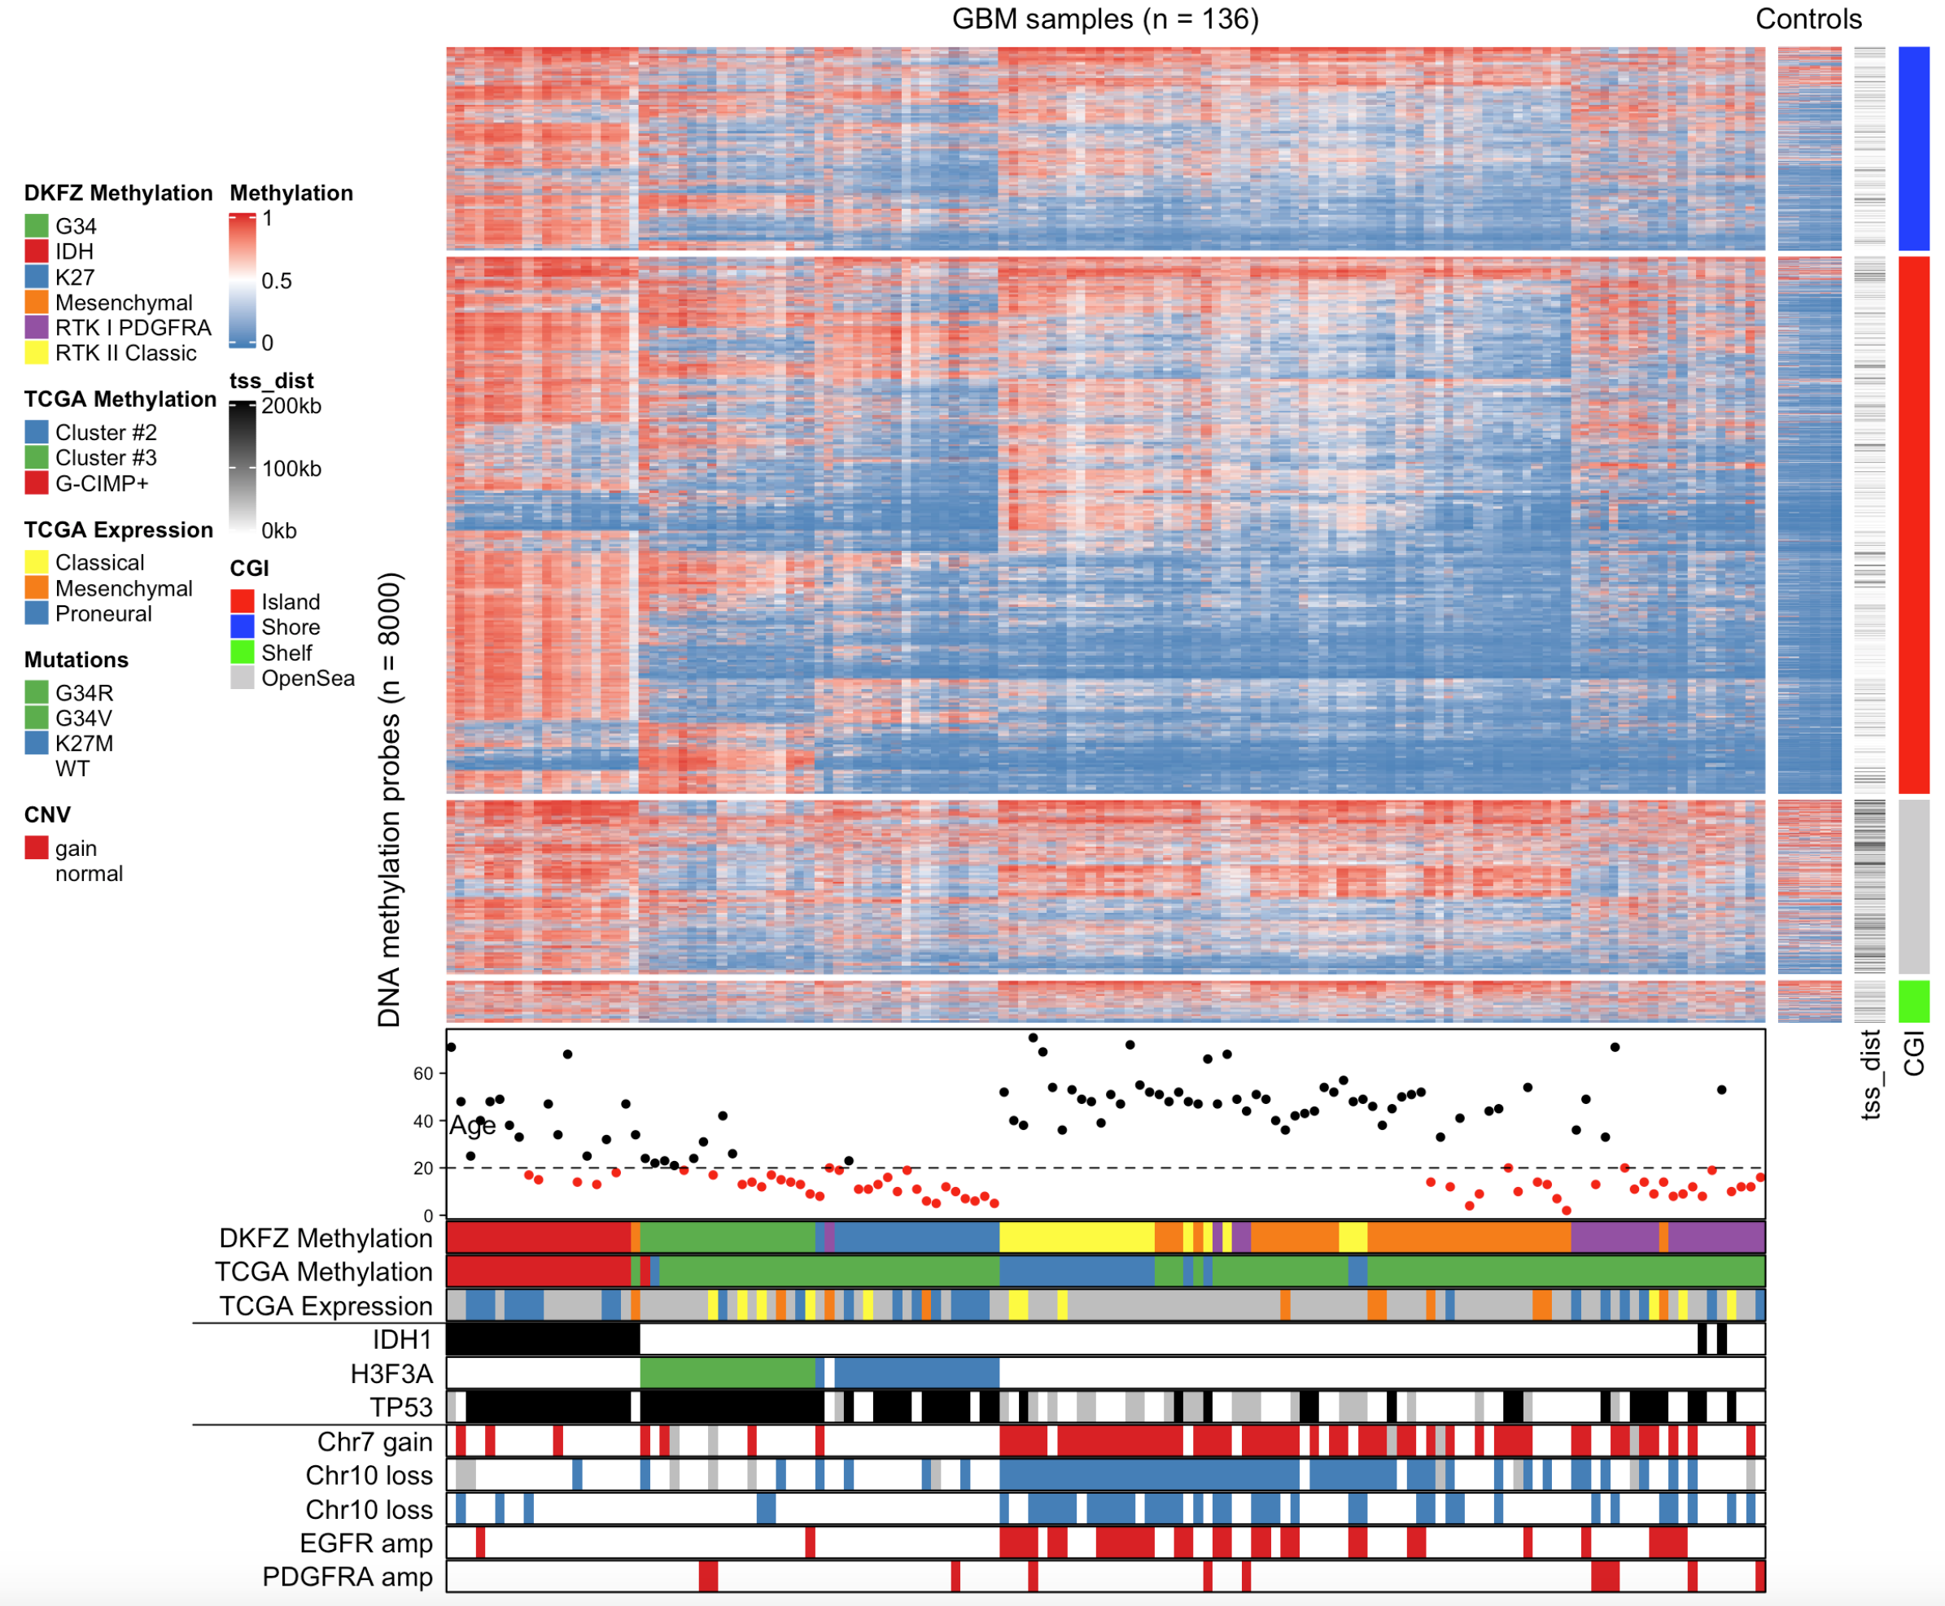
Visualization tools

Slide 18
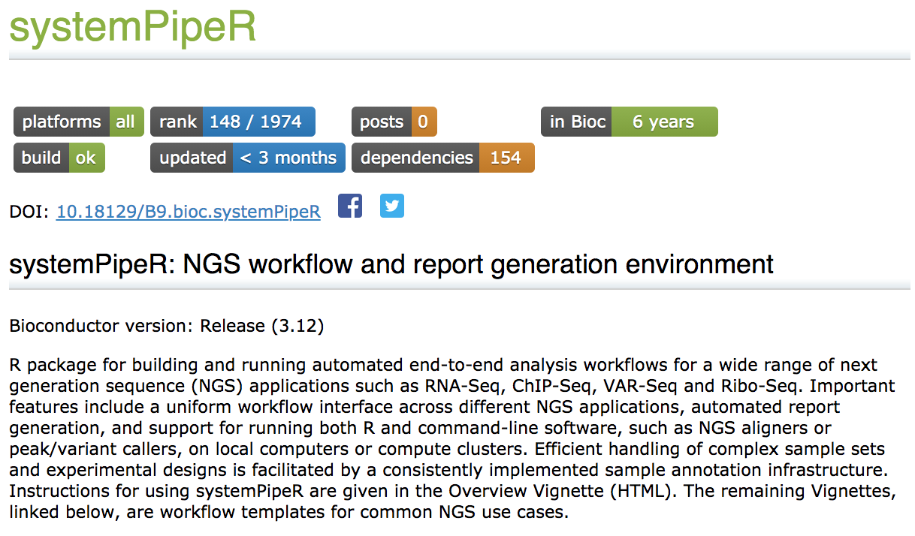
NGS workflow management tools

Slide 19
Reporting tools
DESeq2Report::DESeq2Report(
dds = dds,
project = "OsmoResponse",
intgroup = "timepoint”
)

Slide 20
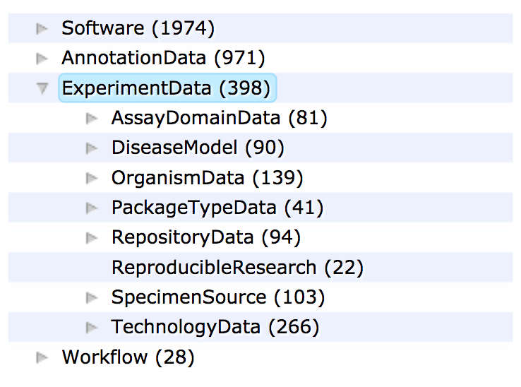
Bioconductor is not only for analysis packages
https://www.bioconductor.org/packages/release/BiocViews.html

Slide 21
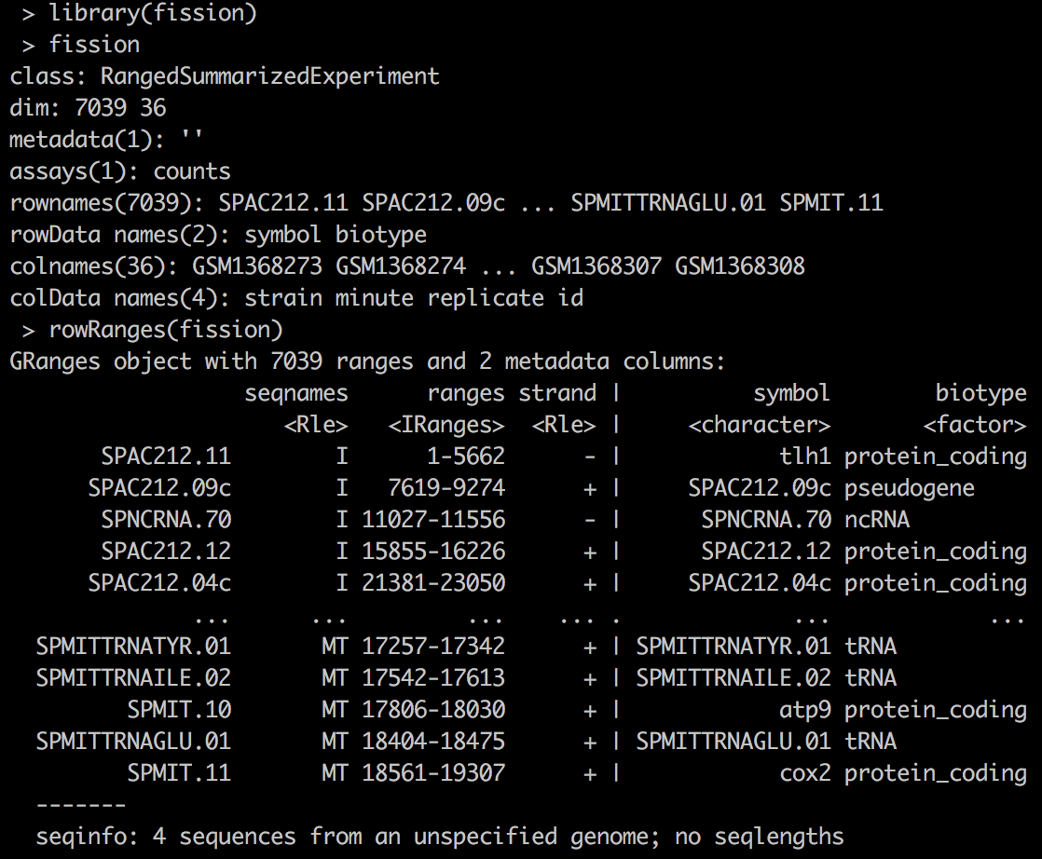
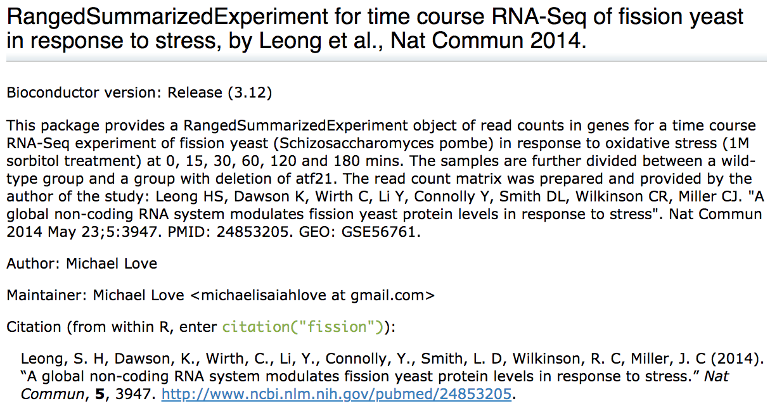
Retrieving specific experiments

Slide 22
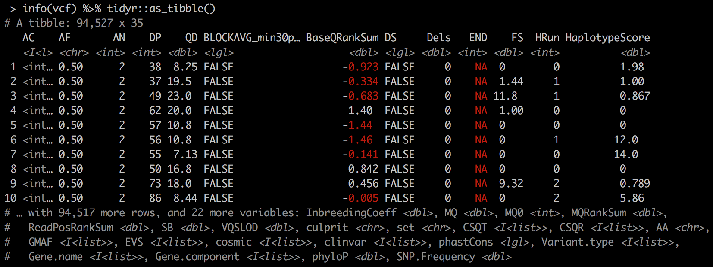
Retrieving specific experiments
library(VariantAnnotation)
vcf <- readVcf(
system.file("extdata", "SonVariantsChr21.vcf.gz", package = "AshkenazimSonChr21"),
genome = "hg19"
)
info(vcf)

Slide 23
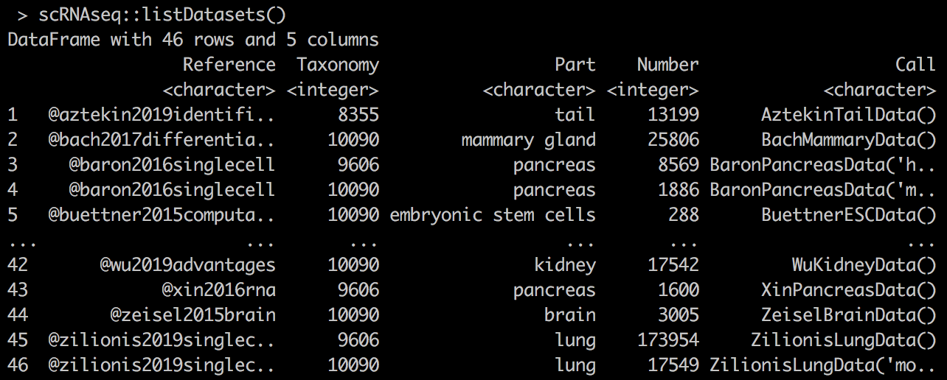
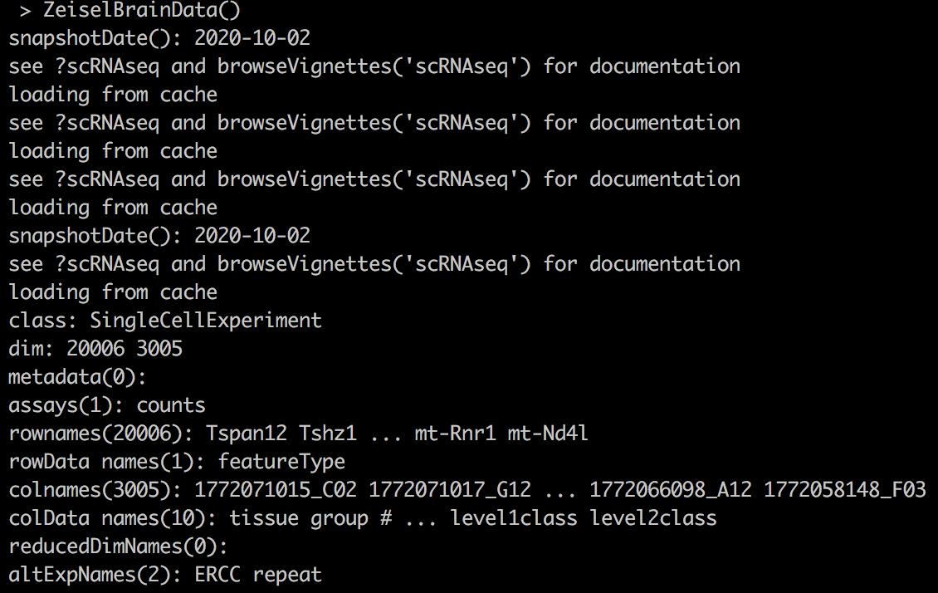
Retrieving specific experiments

Slide 24
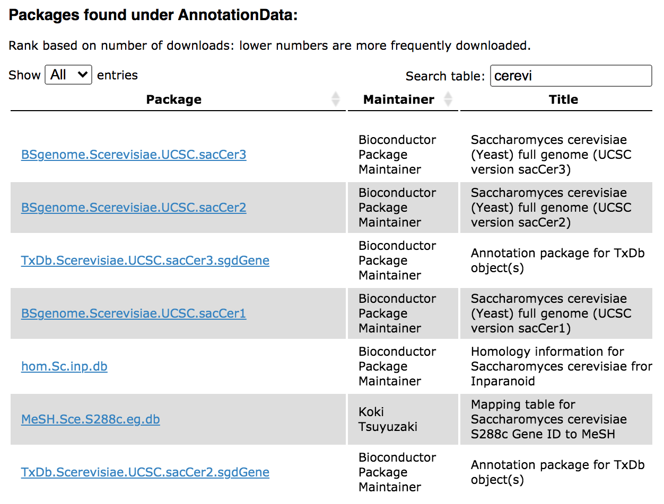
Bioconductor Annotation packages
BS
BS
TxDb
BS
TxDb
org

Slide 25
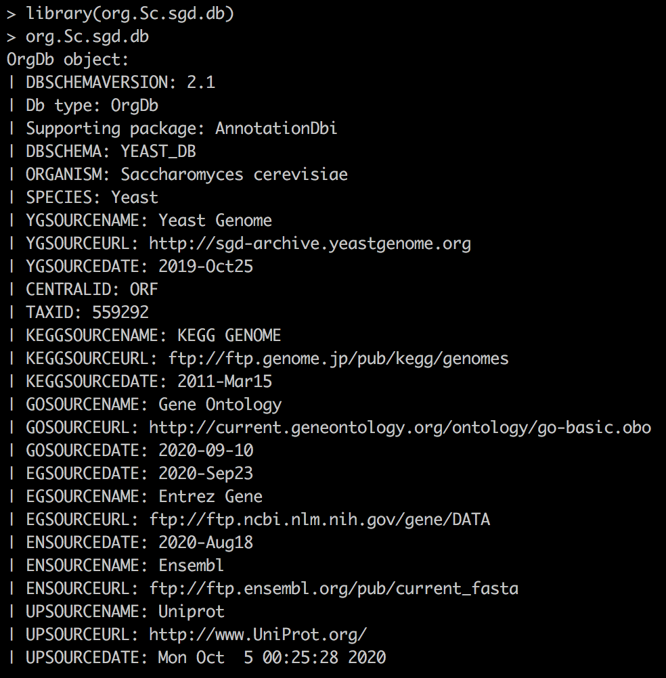
org packages

Slide 26
TxDb packages
A TxDb package connects a set of genomic coordinates to various transcript oriented features.
In other words, TxDb packages provide gene annotation models

Slide 27
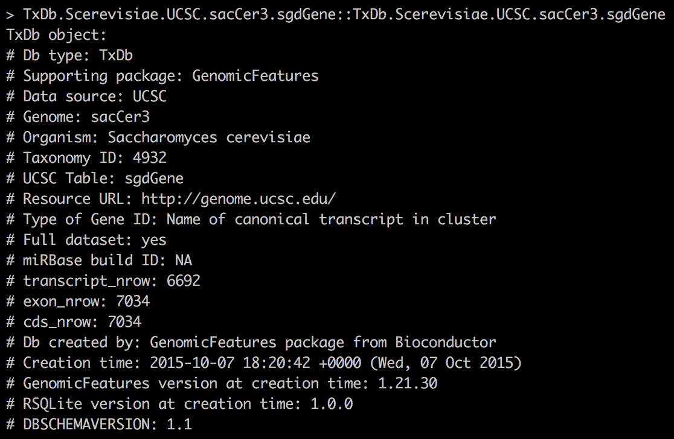
TxDb packages

Slide 28
TxDb packages
TxDb databases can be explored with AnnotationDbi functions

Slide 29
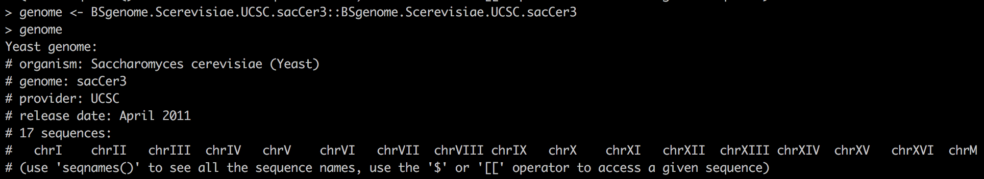
BSgenome packages
Data packages that contain the full genome sequences of a given organism

Slide 30
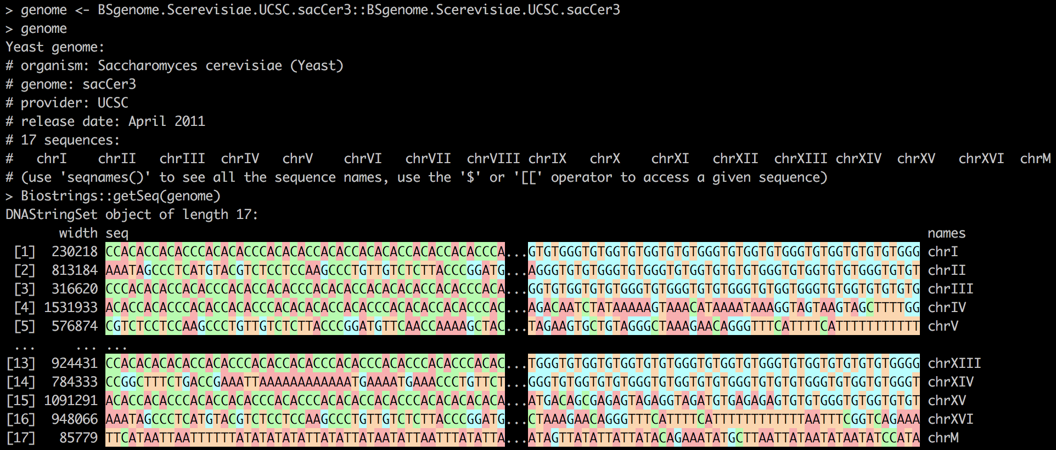
BSgenome packages
Biostrings package is used to interact with BSgenome databases

Slide 31
AnnotationHub: retrieving release-specific files
The AnnotationHub package provides a client interface to resources stored at the AnnotationHub web service
It is different from AnnotationDbi-supported packages (e.g. orgDb or TxDb packages), since it allows access to files on top of databases

Slide 32
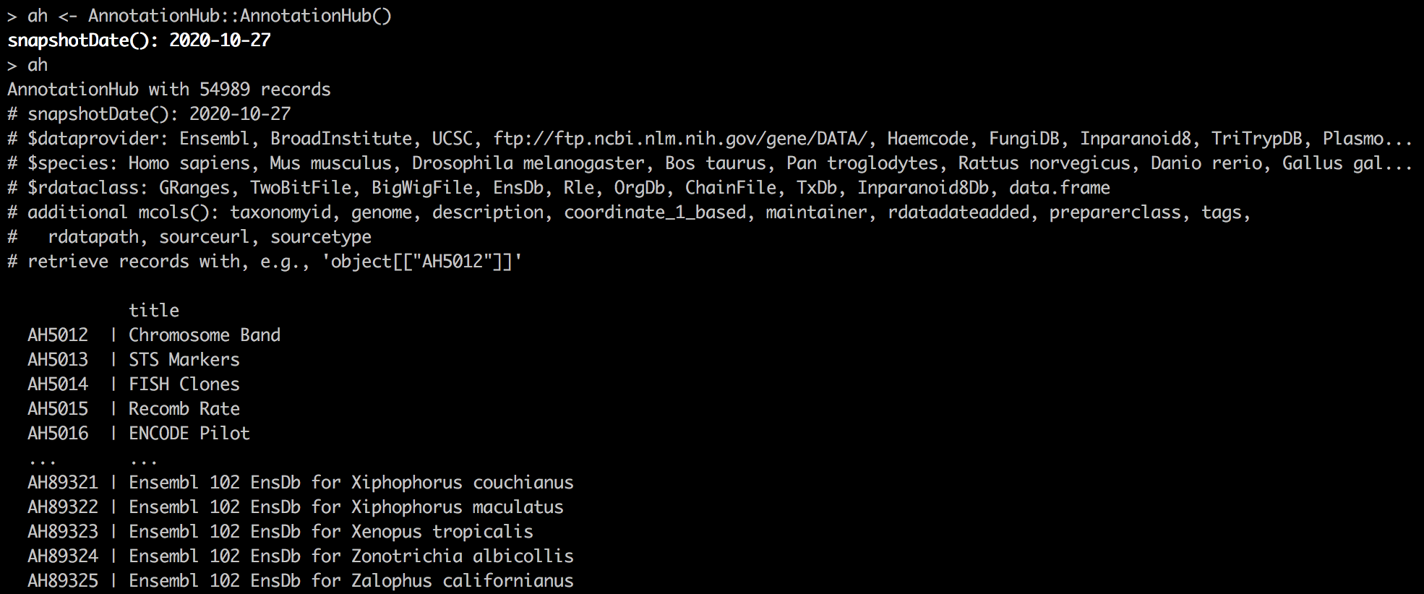
AnnotationHub: retrieving release-specific files
The AnnotationHub package provides a client interface to resources stored at the AnnotationHub web service.

Slide 33
AnnotationHub: retrieving release-specific files
Queries are done using query(ah, “keyword”)

Slide 34
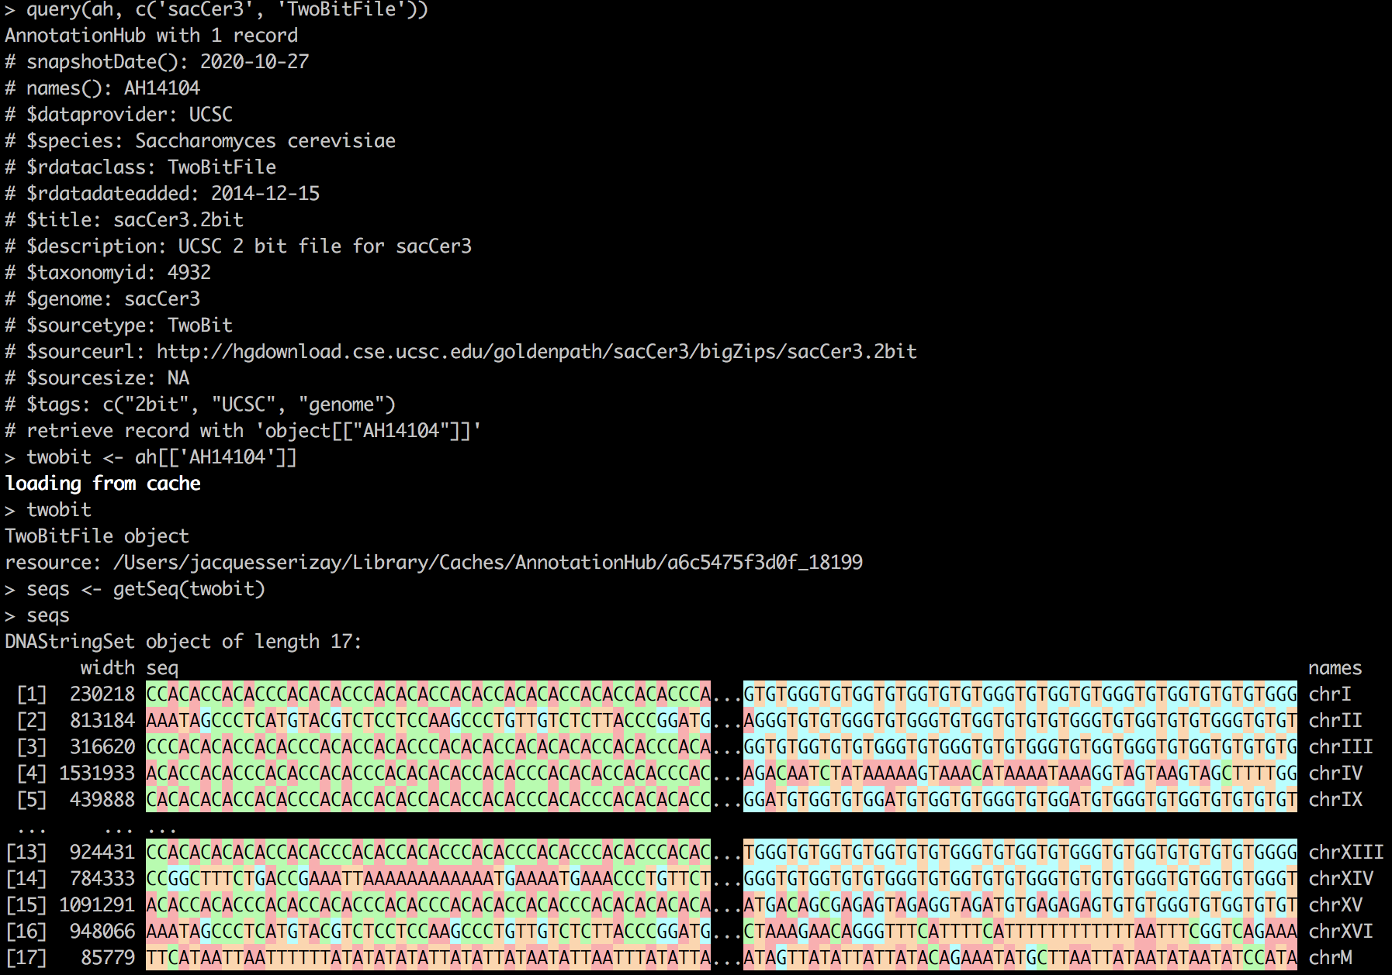
AnnotationHub: retrieving release-specific files
Queries are done using query(ah, “keyword”)

Slide 35
AnnotationHub: retrieving release-specific files
Queries are done using query(ah, “keyword”)
Objects are retrieved using ah[[“…”]]

Slide 36
AnnotationHub: retrieving release-specific files
Many many resources available on AnnotationHub

Slide 37
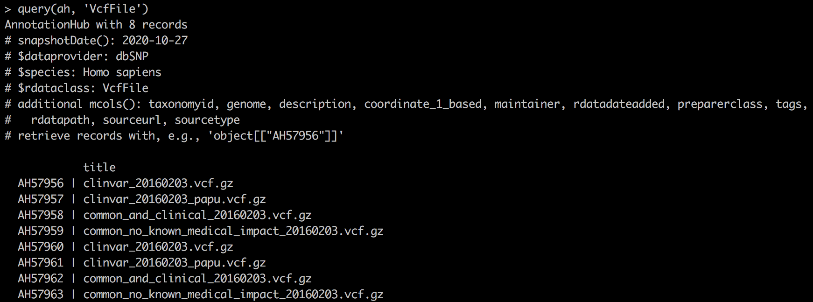
AnnotationHub: retrieving release-specific files

Slide 38
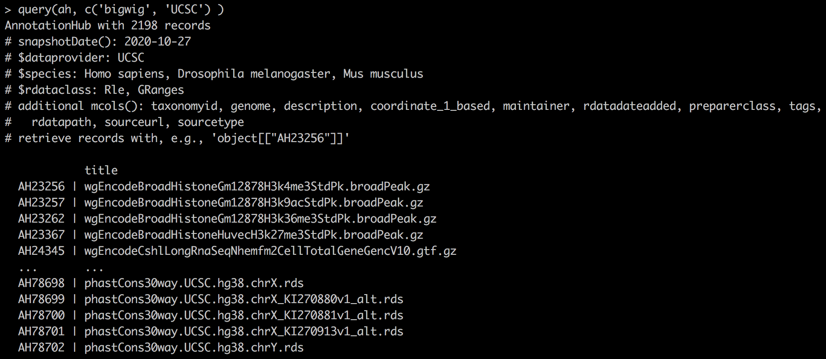
AnnotationHub: retrieving release-specific files

Slide 39
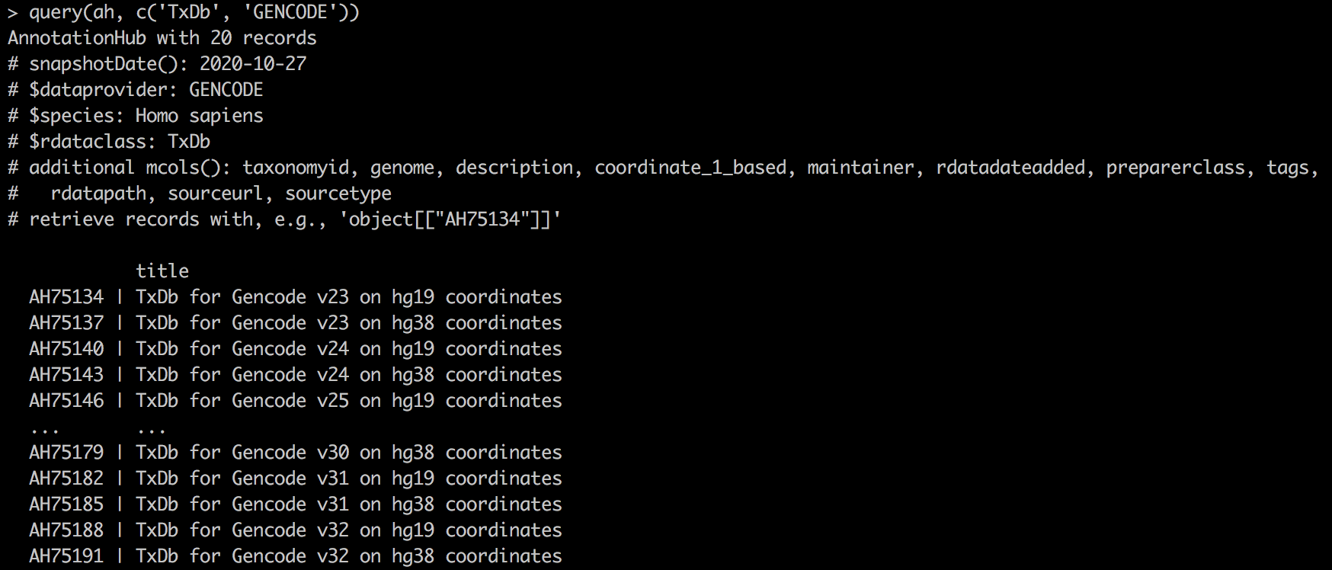
AnnotationHub: retrieving release-specific files

